Slide 1
DNA Methylation
A Brief Introduction
Muhammad Ali
MS Biology
NYU Downtown

Slide 2
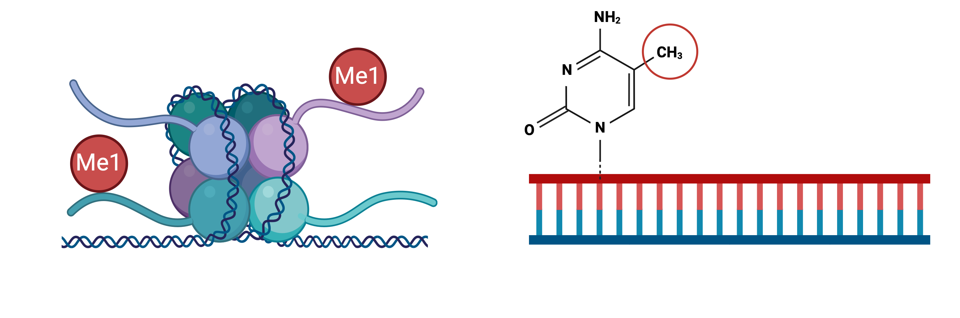

Types of Genomic Methylation
Histone methylation (ChIP-seq)
CpG/DNA methylation (Illumina Arrays)

Slide 3
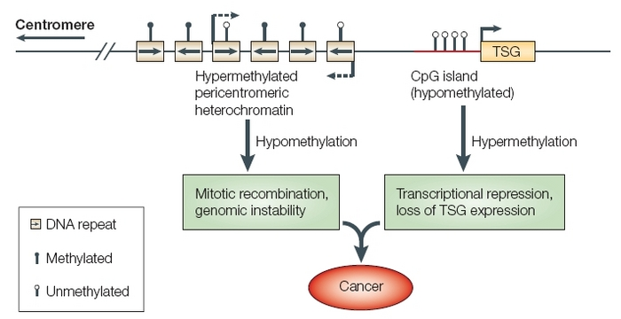
Function of DNAm
Robertson K. D. (2005). DNA methylation and human disease. Nature reviews. Genetics, 6(8), 597–610. https://doi.org/10.1038/nrg1655

Slide 4
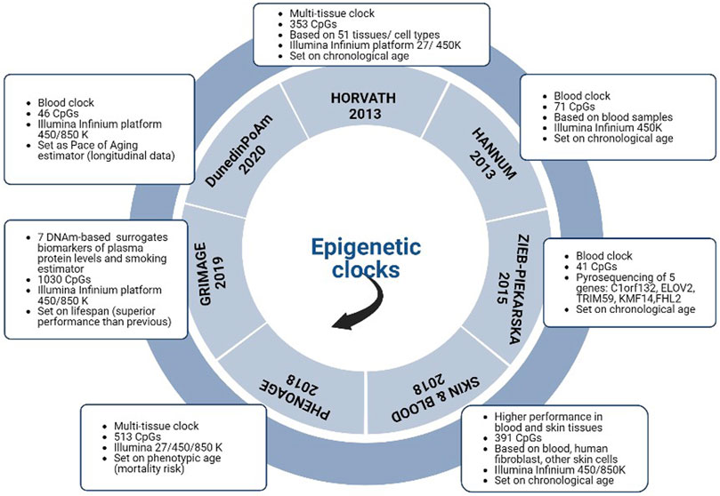
DNAm-based Biomarkers of Aging
Stigler’s Law?
Predicts chronological age
(1st Gen Clocks)
Predicts pace of aging (3rd Gen Clock)
Predicts mortality (2nd Gen Clock)
Predicts biological age (2nd Gen Clock)
Li Piani, L., Vigano', P., & Somigliana, E. (2023). Epigenetic clocks and female fertility timeline: A new approach to an old issue?. Frontiers in cell and developmental biology, 11, 1121231. https://doi.org/10.3389/fcell.2023.1121231

Slide 5
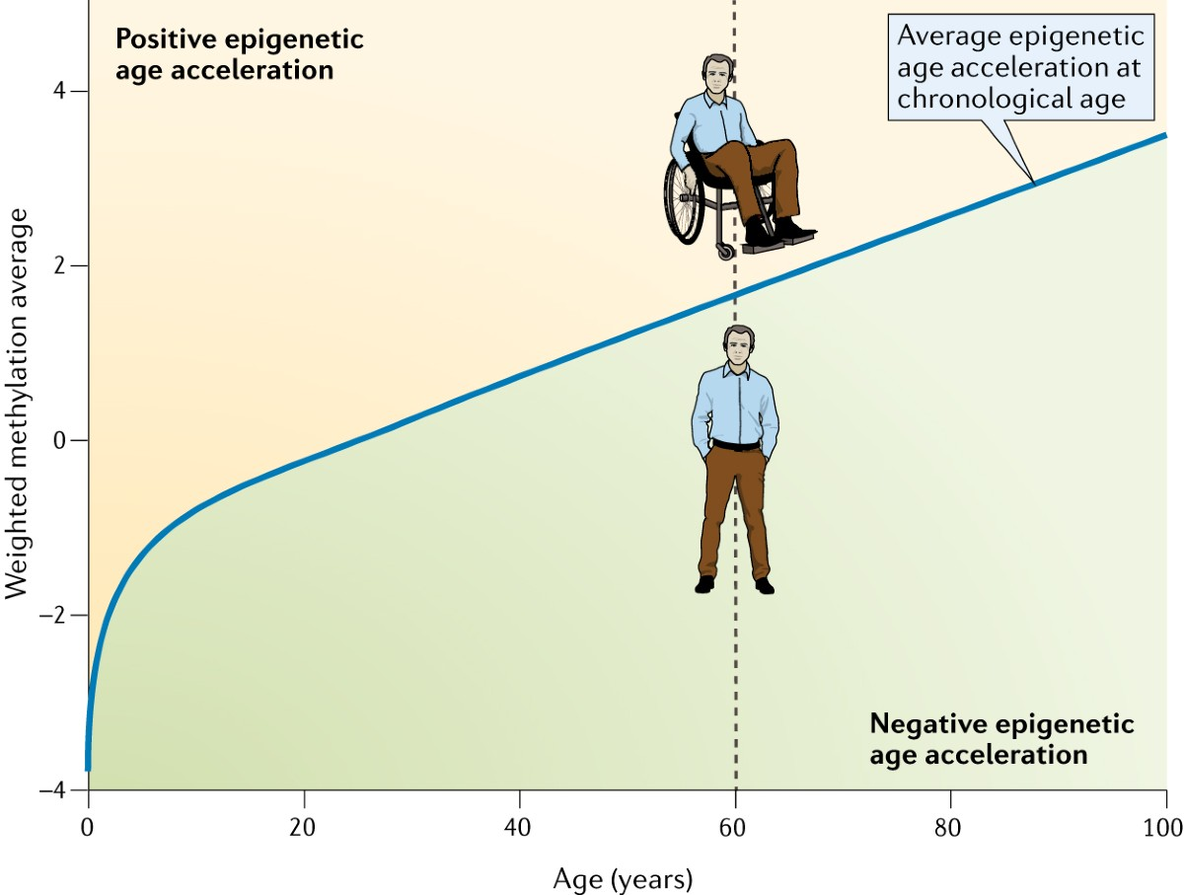


DNAm-based Biomarkers of Aging
Horvath, S., & Raj, K. (2018). DNA methylation-based biomarkers and the epigenetic clock theory of ageing. Nature reviews. Genetics, 19(6), 371–384. https://doi.org/10.1038/s41576-018-0004-3

Slide 6
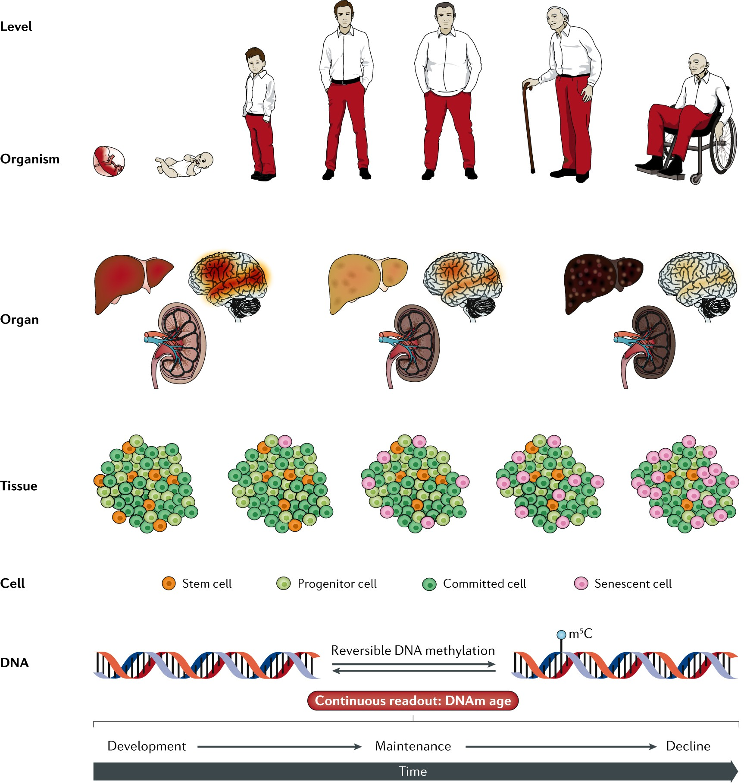
DNAm-based Biomarkers of Aging
Horvath, S., & Raj, K. (2018). DNA methylation-based biomarkers and the epigenetic clock theory of ageing. Nature reviews. Genetics, 19(6), 371–384. https://doi.org/10.1038/s41576-018-0004-3

Slide 7
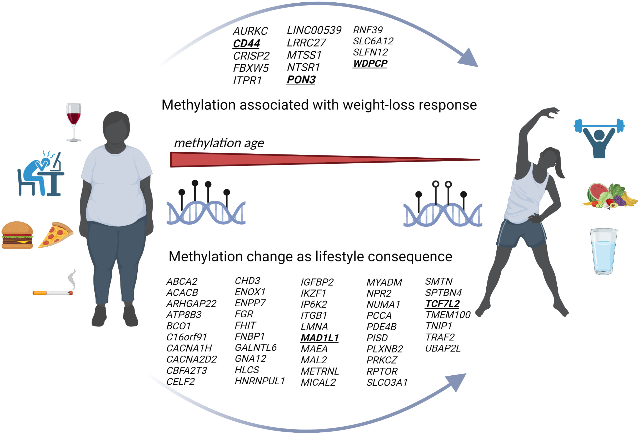
Long-term Impact of Lifestyle
Aurich, S., Müller, L., Kovacs, P., & Keller, M. (2023). Implication of DNA methylation during lifestyle mediated weight loss. Frontiers in endocrinology, 14, 1181002. https://doi.org/10.3389/fendo.2023.1181002

Slide 8
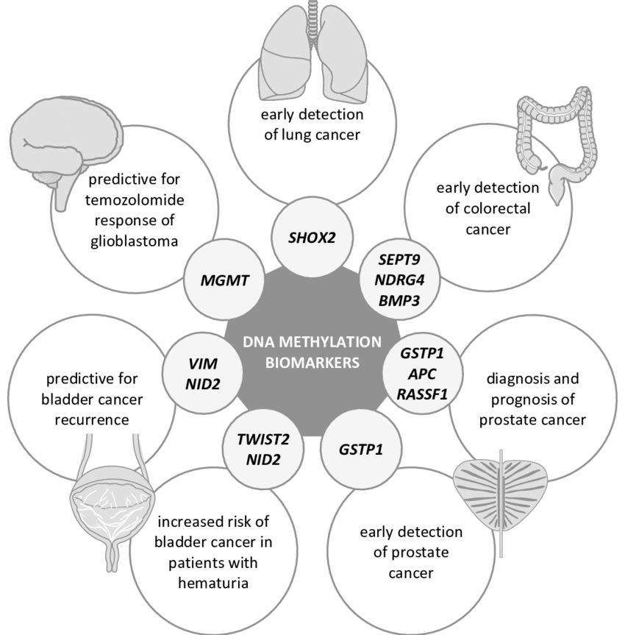
Importance of DNAm Biomarkers
Decock, A. (2016). Exploring the neuroblastoma DNA methylome: from biology to biomarker. Ghent University. Faculty of Medicine and Health Sciences, Ghent, Belgium.

Slide 9
Impact of DNAm Biomarkers
Future-diagnosis (up-to 9 years for EC)
Prognosis
Prevention – lifestyle changes, cancer vaccines, and more.
Treatment – inform better treatment options
CpGs used for prediction may NOT be mechanistically involved in cancer.
Clarification:
CpG methylation is involved in cancer
CpGs used for prediction may NOT (selected using L₁ penalty) have mechanistic relevance

Slide 10
How Do We Get DNAm Data?
Illumina Infinium (genome wide – over >850k CpGs with EPIC) – we need this.
Pyrosequencing (individual genes – not genome wide) – NOT what we use.
Databases:
GEO
TCGA
MethBank
MethDB
MethyCancer

Slide 11
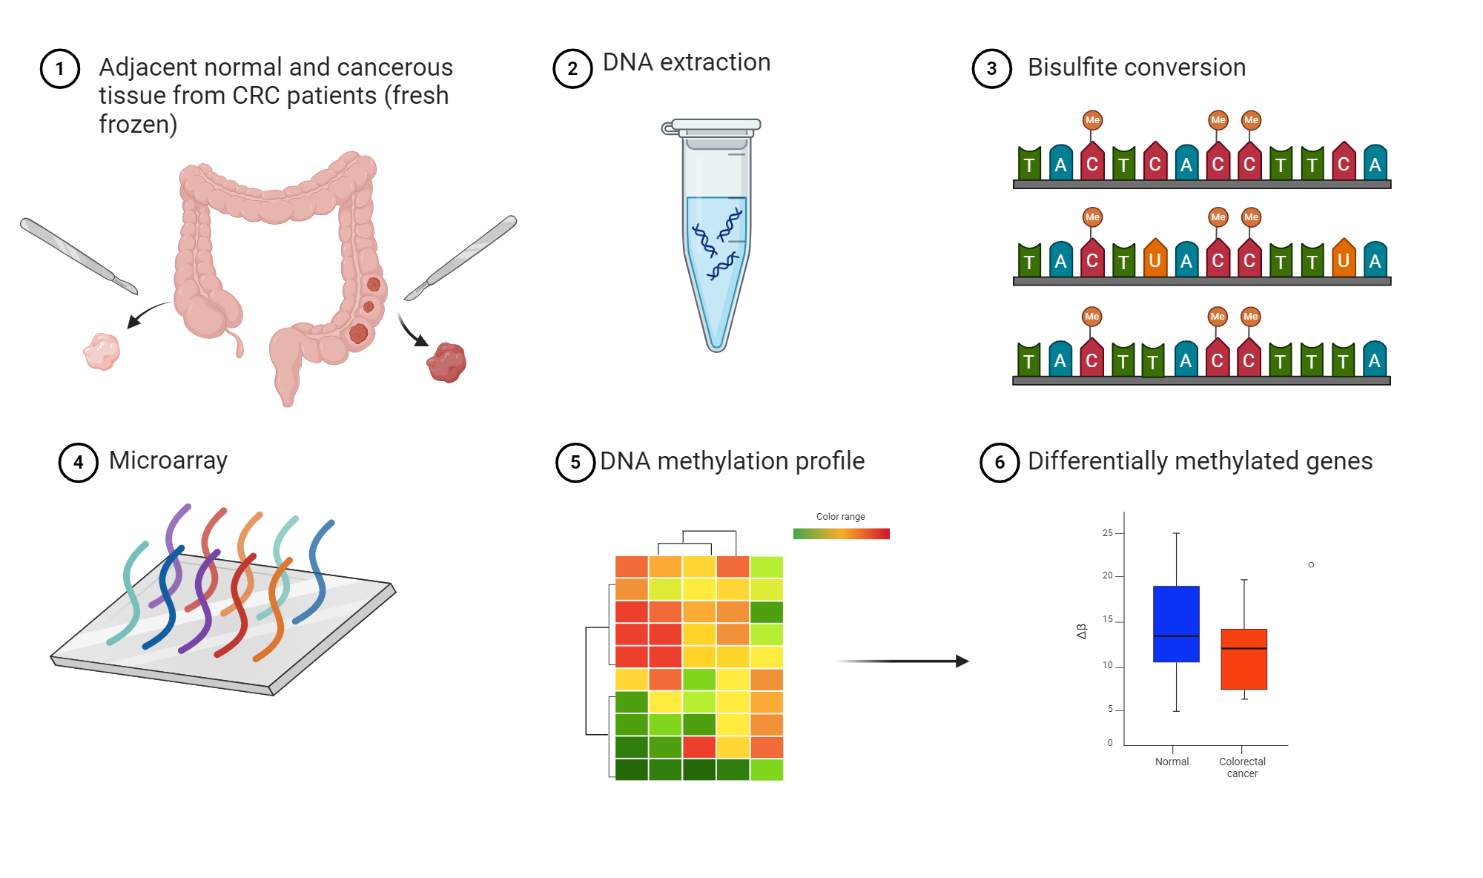
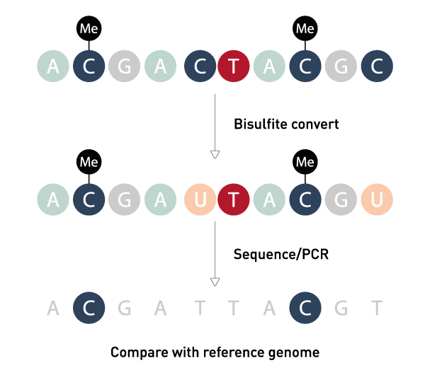
Workflow

Slide 12


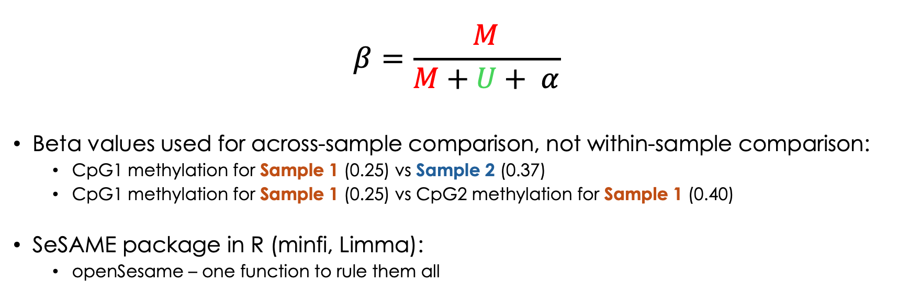
Dyes (Cy3 & Cy5) and Beta Values
$$β=\frac{M}{M+U+ α}$$
Beta values used for across-sample comparison, not within-sample comparison:
CpG1 methylation for Sample 1 (0.25) vs Sample 2 (0.37)
CpG1 methylation for Sample 1 (0.25) vs CpG2 methylation for Sample 1 (0.40)
SeSAME package in R (minfi, Limma):
openSesame – one function to rule them all

Slide 13
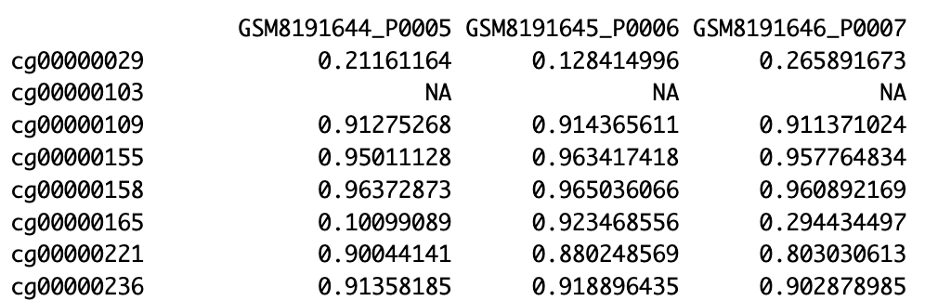
Beta Values

Slide 14
Why did I Choose Methylation?
Cancer is age-associated
DNAm is a cross-species aging biomarker
Predictive modeling of many different conditions
I have some experience in modeling and finding age-associated markers (SkeletAge)
No one else was working on it so it will add one more dimension to the EC study

Slide 15
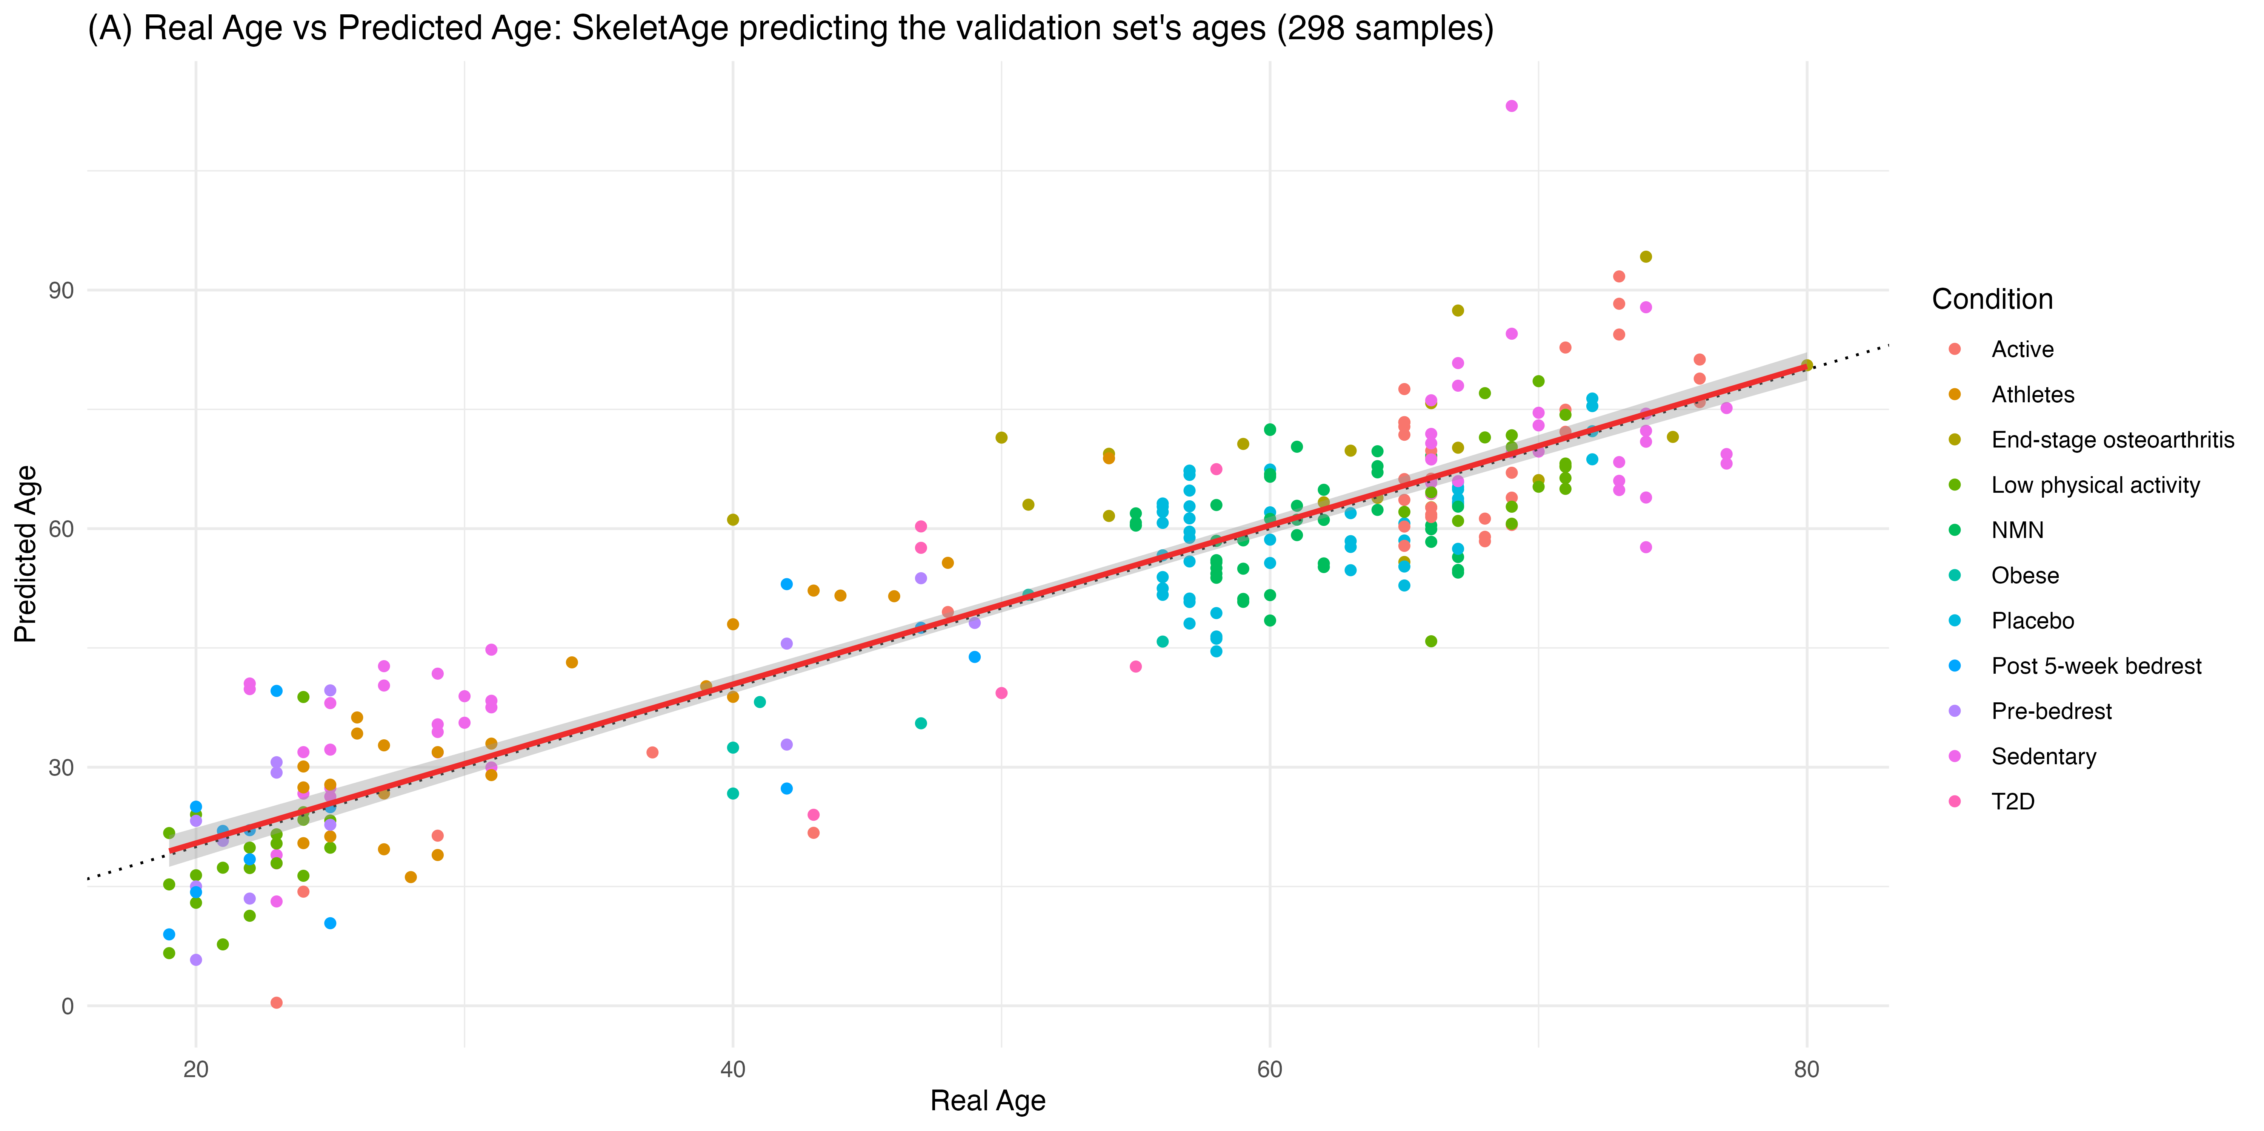
SkeletAge: I Built it
Ali, M., Li, F., & Katari, M. (2025). SkeletAge: Transcriptomics-based aging clock identifies 26 new targets in skeletal muscle aging. Department of Biology, New York University.

Slide 16
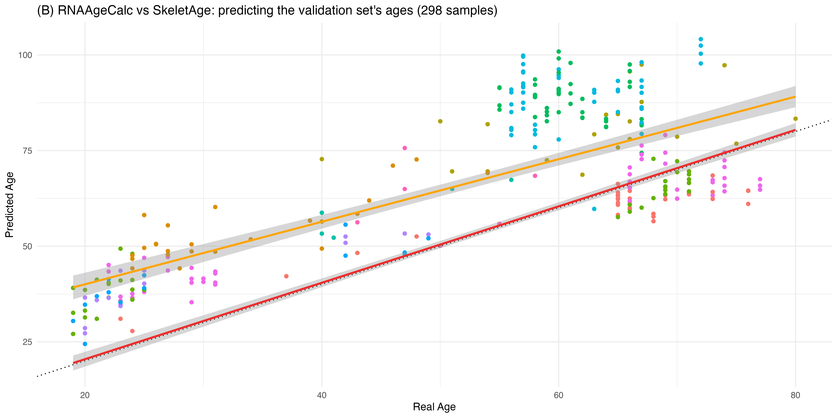
SkeletAge vs RNAAgeCalc
Ali, M., Li, F., & Katari, M. (2025). SkeletAge: Transcriptomics-based aging clock identifies 26 new targets in skeletal muscle aging. Department of Biology, New York University.

Slide 17
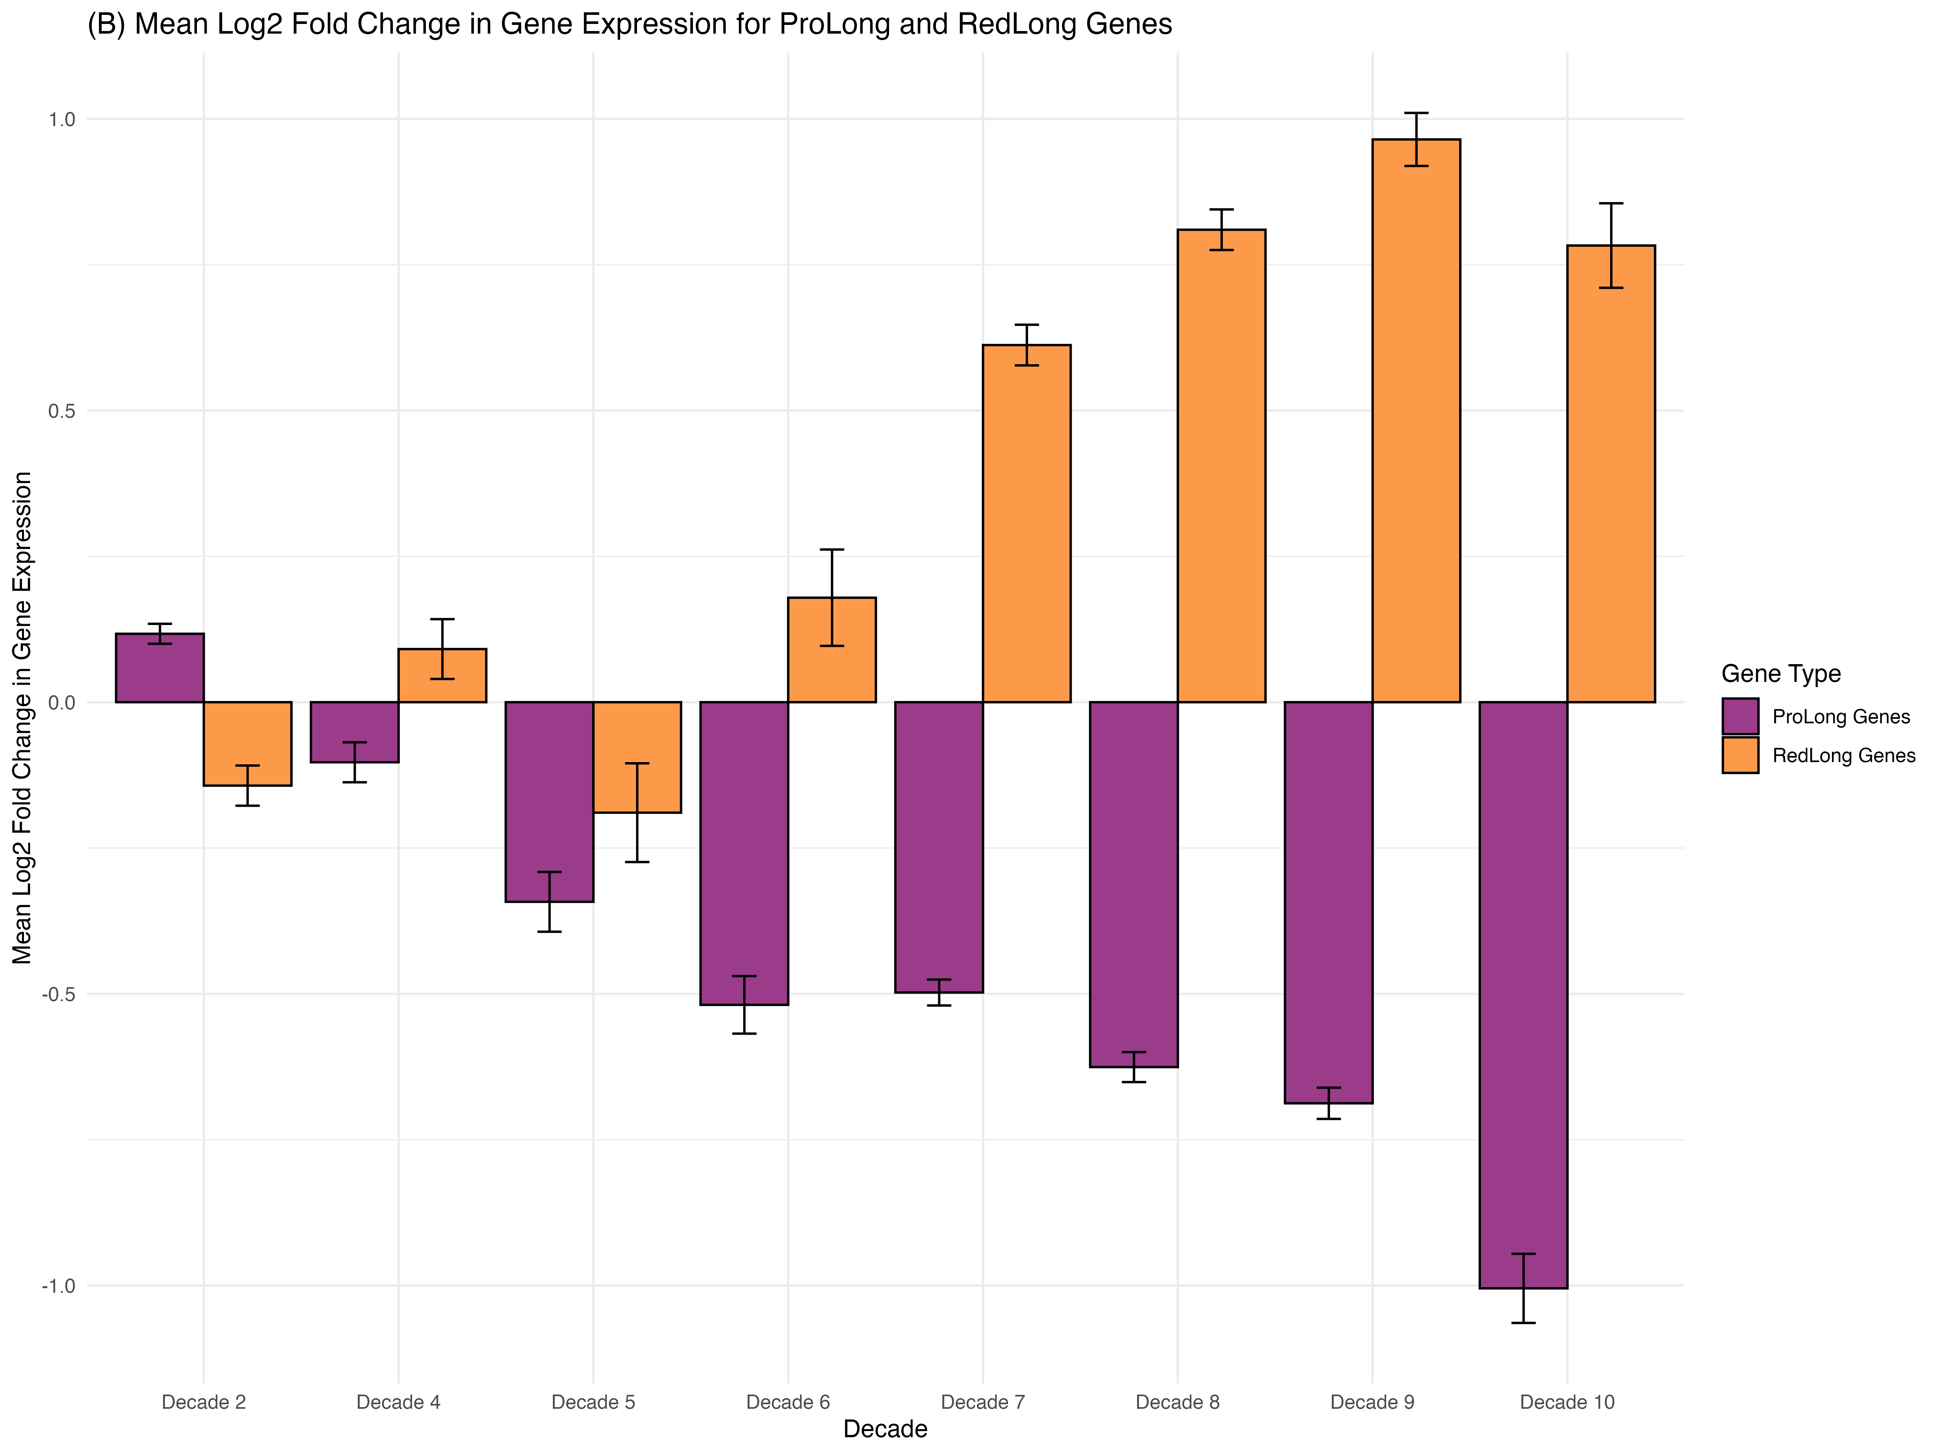
SkeletAge Identified 26 Novel Targets
Ali, M., Li, F., & Katari, M. (Year). SkeletAge: Transcriptomics-based aging clock identifies 26 new targets in skeletal muscle aging. Department of Biology, New York University.

Slide 18
Goals for this Project
Compiling accurate metadata (identified about 1,200 samples) – hardest part
Predict EC from Infinium HM450/850 – (450k – 850k CpGs, respectively)
Predict Future EC from Infinium HM450/850 (survival analysis)
Identify CpGs associated with EC prediction – functional analysis
Create an EpiScore
Correlate with (single-cell)transcriptomics, proteomics, and genome organization (ATAC/Hi-C) –ambitious but would be interesting
Look for cross-species applicability

Slide 19


What’s an EpiScore?
The predicted level of something based on DNAm.
Usually used for protein levels.
Can technically be anything that’s predicted using DNAm.
Patentable & publishable – if there isn’t one already

Slide 20
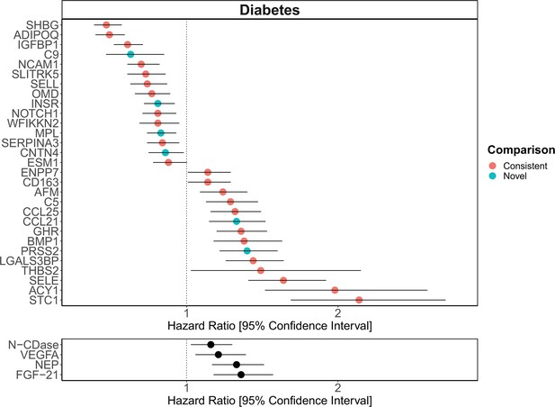
Diabetes HR using Protein EpiScores
Gadd, D. A., Hillary, R. F., McCartney, D. L., Zaghlool, S. B., Stevenson, A. J., Cheng, Y., Fawns-Ritchie, C., Nangle, C., Campbell, A., Flaig, R., Harris, S. E., Walker, R. M., Shi, L., Tucker-Drob, E. M., Gieger, C., Peters, A., Waldenberger, M., Graumann, J., McRae, A. F., Deary, I. J., … Marioni, R. E. (2023). Correction: Epigenetic scores for the circulating proteome as tools for disease prediction. eLife, 12, e94481. https://doi.org/10.7554/eLife.94481

Slide 21

Thanks for Listening!
Happy to answer any questions :)

